Slide 1
MS Directed Project
Chad Mirkovich

Slide 2
Abstract
Detailed Finite Element Models (DFEMS) are becoming the new standard
These are refined loads models
These are not stress models
Goal is to develop a breakout FEM solver within Python, to solve true stress models
Solve refined meshes that use either 4 node quads or 8 node quads with 6/7 node quad transition elements
Validate Python solver with elasticity solutions
Compare mesh convergence rates between 4 and 8 node quadrilateral meshes.

Slide 3
LEFM Use Case
Fatigue and Damage Tolerance (F&DT) analysis within industry uses Linear Elastic Fracture Mechanics (LEFM) software for crack propagation analysis
LFEM Software:
NASGROW
AFGROW
MAGIC
Conducts LEFM analysis for a limited set of known solutions
Results in many situations where the known solution does not reflect the actual condition
Can be due to loading or geometry
Solutions often need to be modified to conservatively represent the actual condition

Slide 4
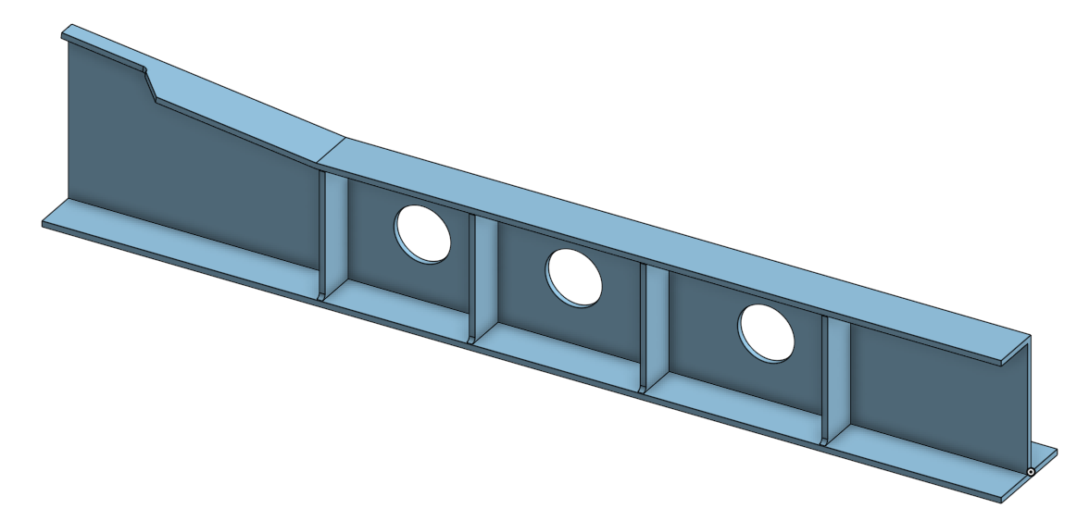
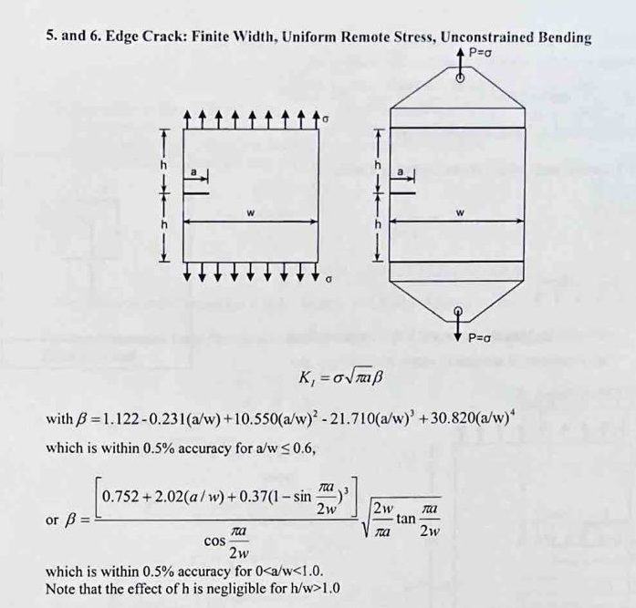
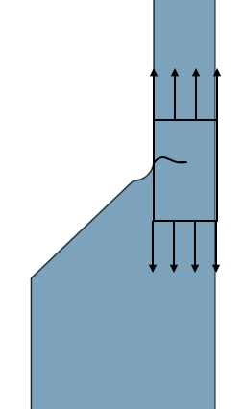
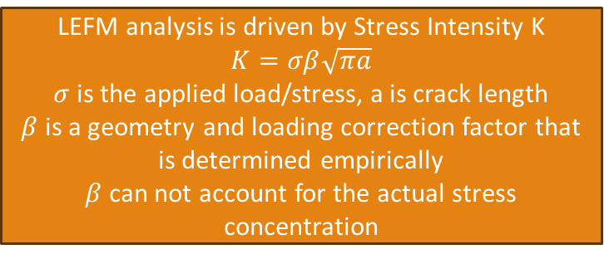
Vertical Frame Edge Crack Ex.
LEFM analysis is driven by Stress Intensity K
$$K=σβ\sqrt{πa}$$
$σ$ is the applied load/stress, a is crack length
$β$ is a geometry and loading correction factor that is determined empirically
$β$ can not account for the actual stress concentration
Notes:
Slow Down

Slide 5
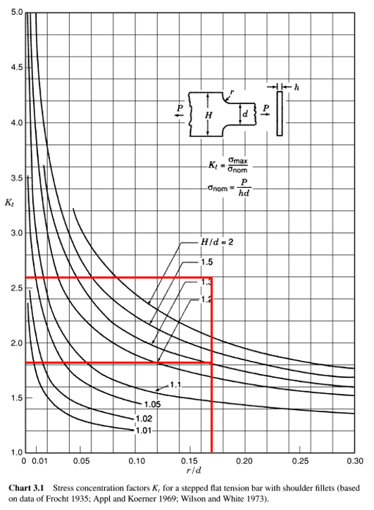
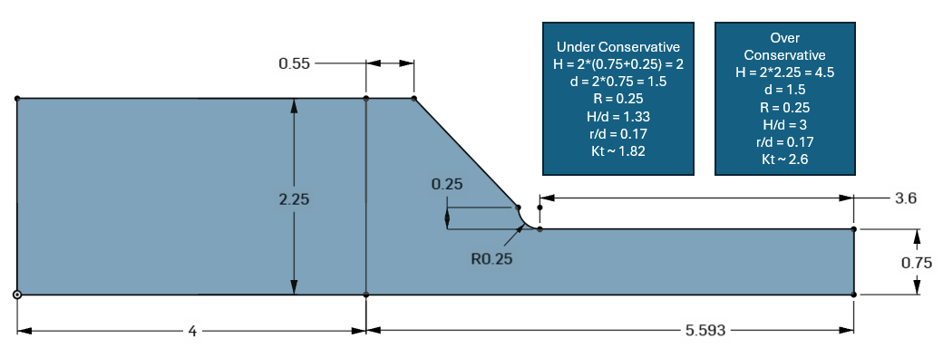

Kt Determination
In addition to the $β$ factor, the kt due to the profile change must be accounted for
Typically use Kt curves from Peterson
Peterson curves do not match actual geometry
Actual Kt could range from 1.82 to 2.6
Would conservatively assume Kt = 2.6
Kt across the plate unknown
Notes:
If perterson’s can not capture the Kt,
Does the FEM Capture it?

Slide 6
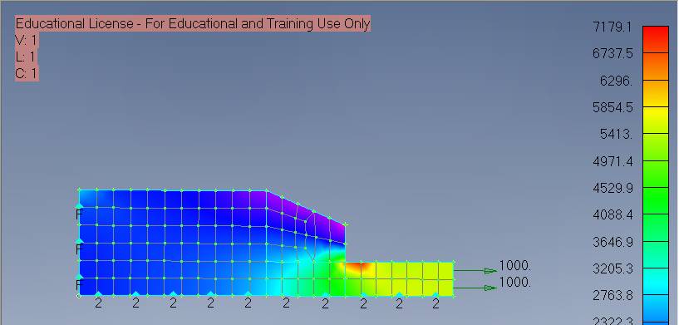
Finite Element Method
Neither NASGROW or Peterson have solutions for the exact geometry shown
Typical AVFEM or loads DFEM would insufficiently model the detail for stress extraction
Propose break out FEM solver to solve a refined mesh of the critical region
4 node quad refinement
8 node quad refinement
Notes:
This is where a break out FEM solver comes in
Refining and solving local, critical details from the DFEM/AVFEM

Slide 7
Solver Derivation
Assumptions:
In-plane loading only (no bending)
Elements are in plane stress
Small deformation
Small rotations
2d stress tensor
No body forces
No surface tractions

Slide 8

Constitutive Equations
Stress Vector: ${\left\{σ\right\}}_{2d}=[\begin{matrix}σ_{x} & σ_{y} & τ_{xy}]\end{matrix}$
Strain Vector: ${\left\{ε\right\}}_{2d}=[\begin{matrix}ε_{x} & ε_{y} & ε_{xy}]\end{matrix}$
Plane stress relationship
$\left\{\begin{matrix}σ_{x} \\ σ_{y} \\ τ_{xy}\end{matrix}\right\}=\frac{E}{1−v^{2}}\left[\begin{matrix}1 & ν & 0 \\ ν & 1 & 0 \\ 0 & 0 & \frac{1−ν}{2}\end{matrix}\right]\left\{\begin{matrix}ε_{x} \\ ε_{y} \\ γ_{xy}\end{matrix}\right\}$

Slide 9
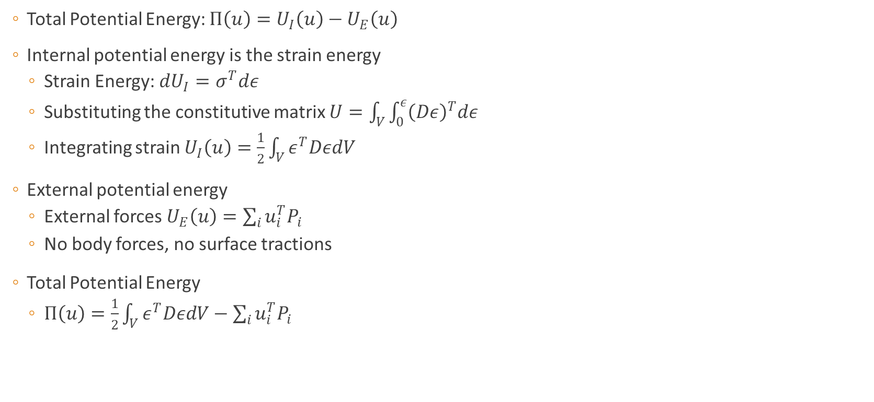
Kinematic Equations
Total Potential Energy: $Π\left(u\right)=U_{I}\left(u\right)−U_{E}\left(u\right)$
Internal potential energy is the strain energy
Strain Energy: $dU_{I}=σ^{T}dε$
Substituting the constitutive matrix $U=\int_{V}{\int_{0}^{ε}{{\left(Dε\right)}^{T}dε}}$
Integrating strain $U_{I}\left(u\right)=\frac{1}{2}\int_{V}{ε^{T}DεdV}$
External potential energy
External forces $U_{E}\left(u\right)=\sum_{i}{u_{i}^{T}P_{i}}$
No body forces, no surface tractions
Total Potential Energy
$Π\left(u\right)=\frac{1}{2}\int_{V}{ε^{T}DεdV}−\sum_{i}{u_{i}^{T}P_{i}}$
Notes:
Work done by internal stresses while deforming or straining the body

Slide 10

Virtual Work
$δΠ\left(u\right)=0$
$δΠ=δU_{I}−δU_{E}=\int_{V}{ε^{T}DδεdV}−\sum_{i}{δu_{i}^{T}P_{i}}=0$
$\int_{V}{ε^{T}DδεdV}=\sum_{i}{δu_{i}^{T}P_{i}}$
With
$\left\{ε\right\}=\left[∂\right]\left[u\right]$ Strain is known to be the partial derivatives of displacement
$\left\{u\right\}=\left[N\right]\{d\}$ Where N is the matrix of shape functions
$\left\{ε\right\}=\left[∂\right]\left[N\right]\{d\}$
Define B as $\left[∂\right][N]$
$\left\{ε\right\}=\left[B\right]\{d\}$
$\int_{V}{B^{T}DBdV}\left\{d\right\}=P, \left[k\right]\left\{d\right\}=\{P\}$
Notes:
Virtual work = 0 establishes equilibrium

Slide 11
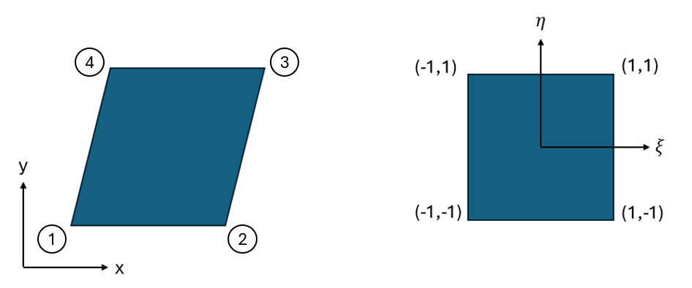
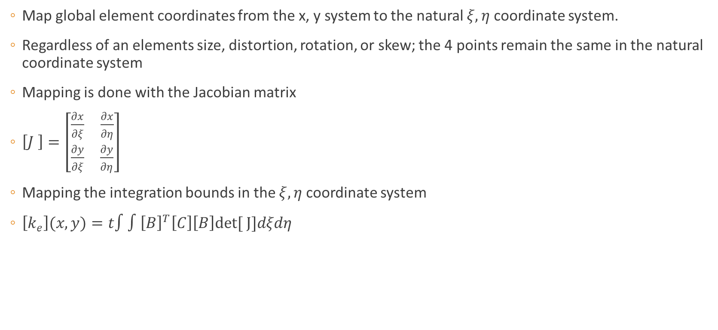
Natural Coordinate System
Map global element coordinates from the x, y system to the natural $ξ, η$ coordinate system.
Regardless of an elements size, distortion, rotation, or skew; the 4 points remain the same in the natural coordinate system
Mapping is done with the Jacobian matrix
$\left[J \right]=\left[\begin{matrix}\frac{∂x}{∂ξ} & \frac{∂x}{∂η} \\ \frac{∂y}{∂ξ} & \frac{∂y}{∂η}\end{matrix}\right]$
Mapping the integration bounds in the $ξ, η$ coordinate system
$\left[k_{e}\right](x, y)=t∫∫{\left[B\right]}^{T}\left[C\right]\left[B\right]det[ J]dξdη$
Notes:
To Integrate over the volume SLOW DOWN

Slide 12
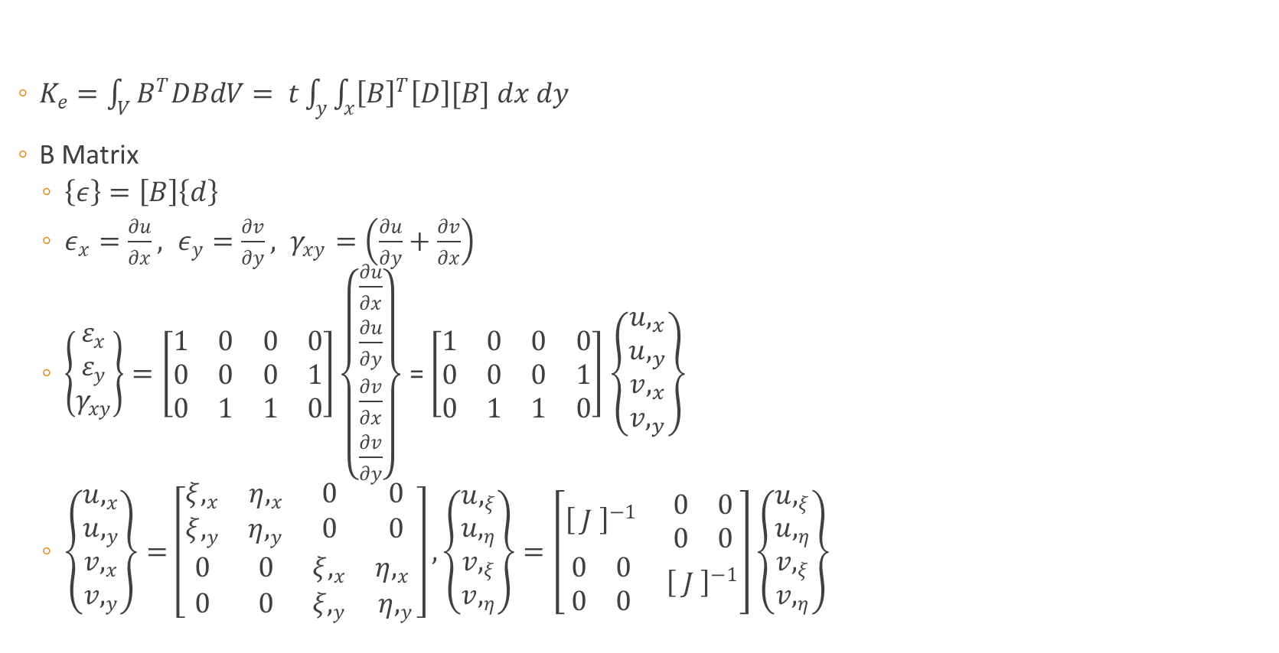
Stiffness / B Matrix Derivation
$K_{e}=\int_{V}{B^{T}DBdV}= t\int_{y}{\int_{x}{{\left[B\right]}^{T}\left[D\right][B] dx dy}}$
B Matrix
$\left\{ε\right\}=\left[B\right]\left\{d\right\}$
$ε_{x}=\frac{∂u}{∂x}, ε_{y}=\frac{∂v}{∂y}, γ_{xy}=\left(\frac{∂u}{∂y}+\frac{∂v}{∂x}\right)$
$\left\{\begin{matrix}ε_{x} \\ ε_{y} \\ γ_{xy}\end{matrix}\right\}=\left[\begin{matrix}1 & 0 & 0 & 0 \\ 0 & 0 & 0 & 1 \\ 0 & 1 & 1 & 0\end{matrix}\right]\left\{\begin{matrix}\frac{∂u}{∂x} \\ \frac{∂u}{∂y} \\ \frac{∂v}{∂x} \\ \frac{∂v}{∂y}\end{matrix}\right\}$ = $\left[\begin{matrix}1 & 0 & 0 & 0 \\ 0 & 0 & 0 & 1 \\ 0 & 1 & 1 & 0\end{matrix}\right]$ $\left\{\begin{matrix}u,_{x} \\ u,_{y} \\ v,_{x} \\ v,_{y}\end{matrix}\right\}$
$\left\{\begin{matrix}u,_{x} \\ u,_{y} \\ v,_{x} \\ v,_{y}\end{matrix}\right\}=\left[\begin{matrix}ξ,_{x} & η,_{x} & 0 & 0 \\ ξ,_{y} & η,_{y} & 0 & 0 \\ 0 & 0 & ξ,_{x} & η,_{x} \\ 0 & 0 & ξ,_{y} & η,_{y}\end{matrix}\right], \left\{\begin{matrix}u,_{ξ} \\ u,_{η} \\ v,_{ξ} \\ v,_{η}\end{matrix}\right\}=\left[\begin{matrix}{\left[ J \right]}^{−1} & \begin{matrix}0 & 0 \\ 0 & 0\end{matrix} \\ \begin{matrix}0 & 0 \\ 0 & 0\end{matrix} & {\left[ J \right]}^{−1}\end{matrix}\right]\left\{\begin{matrix}u,_{ξ} \\ u,_{η} \\ v,_{ξ} \\ v,_{η}\end{matrix}\right\}$
Notes:
Using the multi variable chain rule

Slide 13
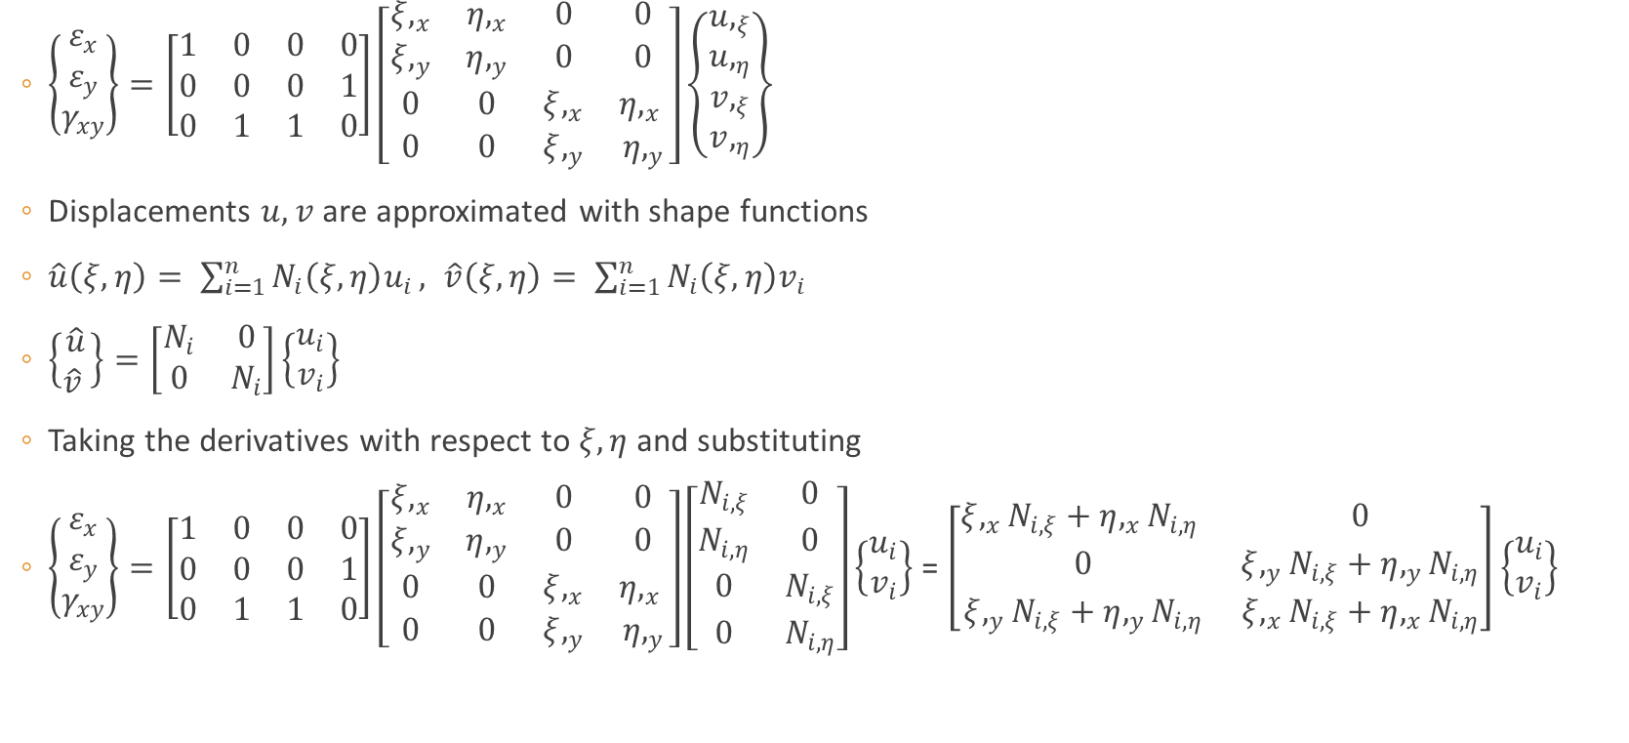
B Matrix Derivation Continued
$\left\{\begin{matrix}ε_{x} \\ ε_{y} \\ γ_{xy}\end{matrix}\right\}=\left[\begin{matrix}1 & 0 & 0 & 0 \\ 0 & 0 & 0 & 1 \\ 0 & 1 & 1 & 0\end{matrix}\right]\left[\begin{matrix}ξ,_{x} & η,_{x} & 0 & 0 \\ ξ,_{y} & η,_{y} & 0 & 0 \\ 0 & 0 & ξ,_{x} & η,_{x} \\ 0 & 0 & ξ,_{y} & η,_{y}\end{matrix}\right]\left\{\begin{matrix}u,_{ξ} \\ u,_{η} \\ v,_{ξ} \\ v,_{η}\end{matrix}\right\}$
Displacements $u, v$ are approximated with shape functions
$\hat{u}\left(ξ,η\right)= \sum_{i=1}^{n}{N_{i}\left(ξ, η\right)u_{i}}, \hat{v}\left(ξ,η\right)= \sum_{i=1}^{n}{N_{i}\left(ξ,η\right)v_{i}}$
$\left\{\begin{matrix}\hat{u} \\ \hat{v} \end{matrix}\right\}=\left[\begin{matrix}N_{i} & 0 \\ 0 & N_{i}\end{matrix}\right]\left\{\begin{matrix}u_{i} \\ v_{i}\end{matrix}\right\}$
Taking the derivatives with respect to $ξ, η$ and substituting
$\left\{\begin{matrix}ε_{x} \\ ε_{y} \\ γ_{xy}\end{matrix}\right\}=\left[\begin{matrix}1 & 0 & 0 & 0 \\ 0 & 0 & 0 & 1 \\ 0 & 1 & 1 & 0\end{matrix}\right]\left[\begin{matrix}ξ,_{x} & η,_{x} & 0 & 0 \\ ξ,_{y} & η,_{y} & 0 & 0 \\ 0 & 0 & ξ,_{x} & η,_{x} \\ 0 & 0 & ξ,_{y} & η,_{y}\end{matrix}\right]\left[\begin{matrix}N_{i,ξ} & 0 \\ N_{i,η} & 0 \\ 0 & N_{i,ξ} \\ 0 & N_{i,η}\end{matrix}\right]\left\{\begin{matrix}u_{i} \\ v_{i}\end{matrix}\right\}$ = $\left[\begin{matrix}ξ,_{x}N_{i,ξ}+η,_{x}N_{i,η} & 0 \\ 0 & ξ,_{y}N_{i,ξ}+η,_{y}N_{i, η} \\ ξ,_{y}N_{i,ξ}+η,_{y}N_{i, η} & ξ,_{x}N_{i,ξ}+η,_{x}N_{i,η}\end{matrix}\right]\left\{\begin{matrix}u_{i} \\ v_{i}\end{matrix}\right\}$

Slide 14
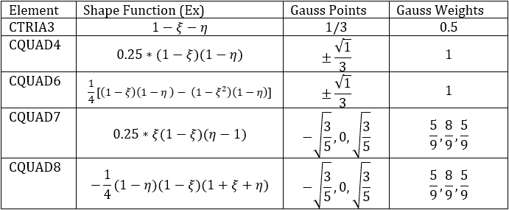
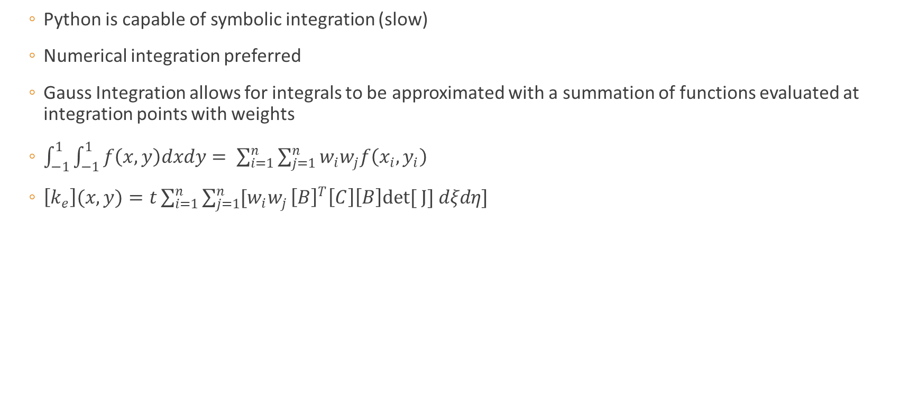
Gauss Integration
Python is capable of symbolic integration (slow)
Numerical integration preferred
Gauss Integration allows for integrals to be approximated with a summation of functions evaluated at integration points with weights
$\int_{−1}^{1}{\int_{−1}^{1}{f\left(x,y\right)dxdy}= \sum_{i=1}^{n}{\sum_{j=1}^{n}{w_{i}w_{j}f\left(x_{i}, y_{i}\right)}}}$
$\left[k_{e}\right](x, y)=t\sum_{i=1}^{n}{\sum_{j=1}^{n}{[w_{i}w_{j}}}{\left[B\right]}^{T}\left[C\right]\left[B\right]det[ J] dξdη]$
Notes:
3rd order
5th order

Slide 15
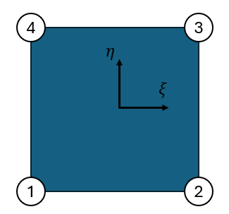
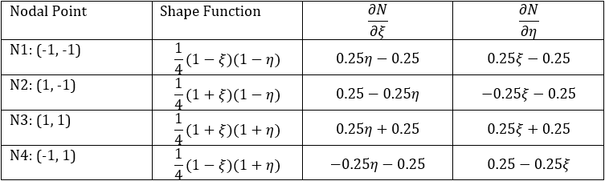
CQUAD4
Bilinear shape functions
Notes:
Biliner, ie linear in each direction $ξ, η$

Slide 16
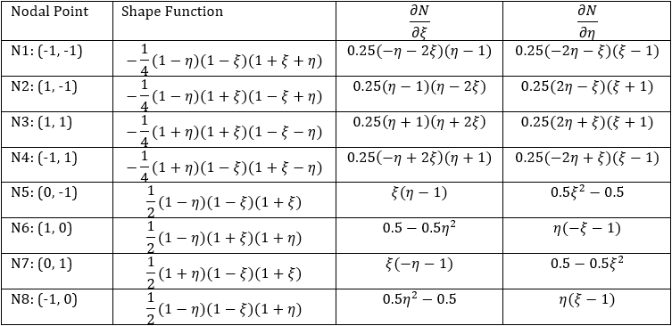
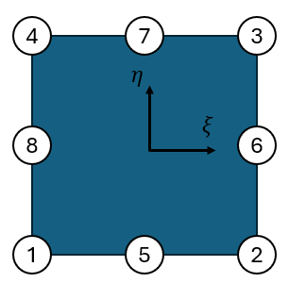
CQUAD8
All quadratic Functions

Slide 17
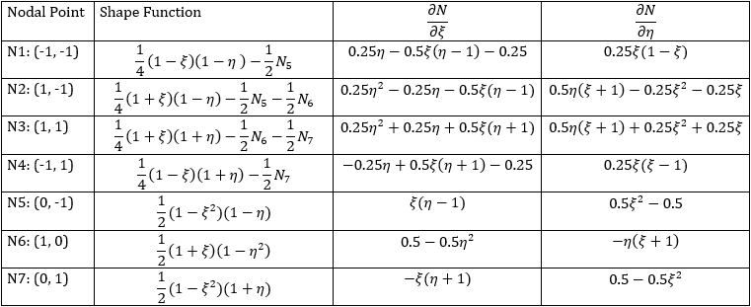
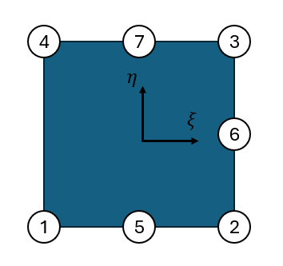
CQUAD7
Linear interpolation between nodes 1 & 4 consistent with CQ4

Slide 18
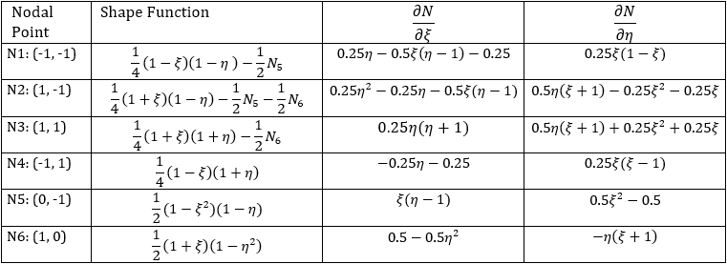
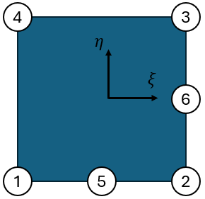
CQUAD6
Linear interpolation between nodes 1&4, 4&3 consistent with CQ4
Notes:
When evaluated at the free edges the shape functions are linear

Slide 19
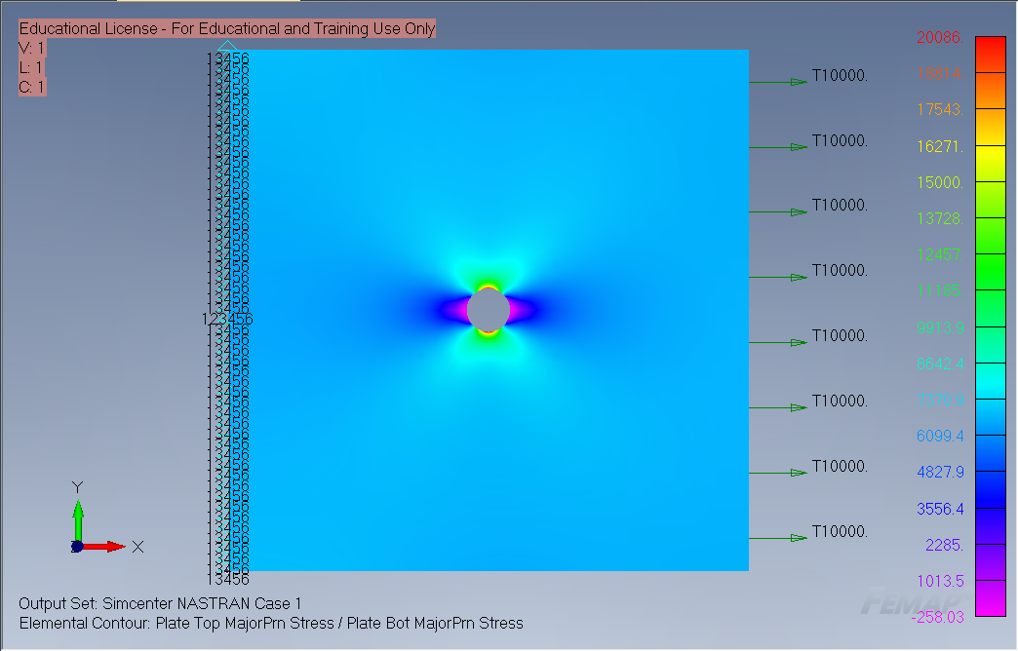
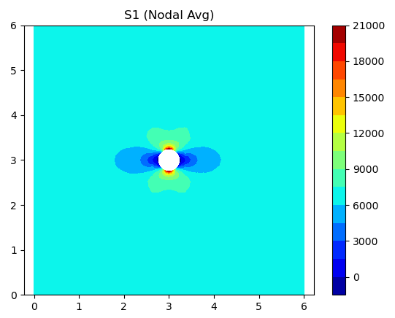


Python Solver Validation
FEMAP
$$σ=20.086 ksi$$
Python
CQ4 = 20.373 ksi
CQ8/7 = 19.624 ksi
Elasticity Solution
$$σ_{gross}=\frac{1000 lbf}{6in∗0.25in}= 6.67 ksi$$
$$σ_{max}=20.086 ksi$$
$$Kt=\frac{σ_{max}}{σ_{gross}}=\frac{20.086}{6.67}=3.01$$
Notes:
Python solver
CQ4 1.9% error
CQ8 1.8% error

Slide 20
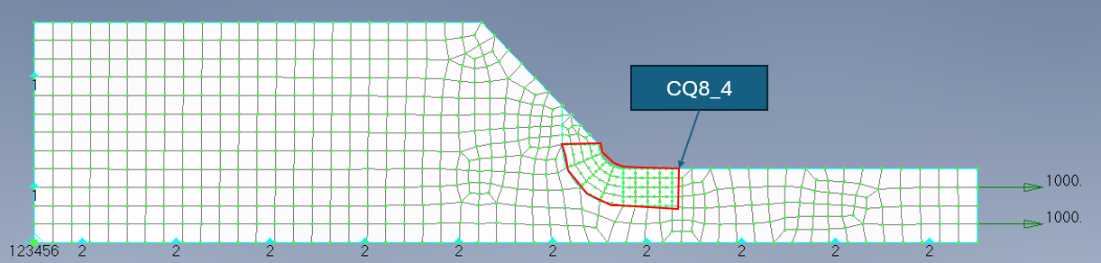
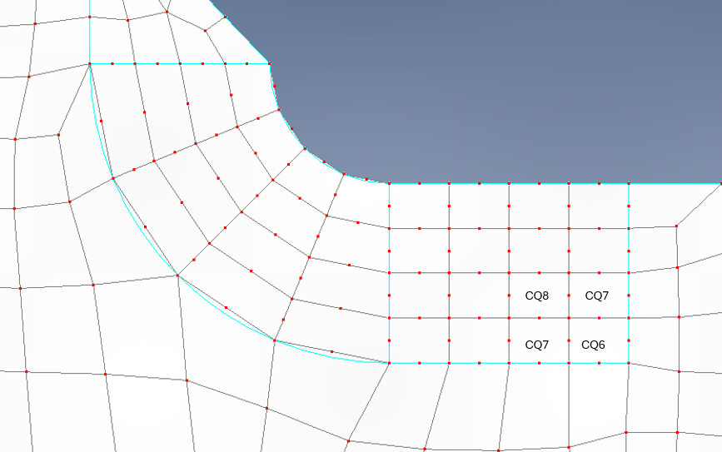
Stress Concentration Determination
DFEM Setup
Free Nodes
Notes:
Constraints!! Loading!! Free nodes are left in femap and dat file
Python solver sees the number of free nodes and determines the CQ7 and CQ6 elements
As seen femap does not have non-straight CQ8 edges

Slide 21
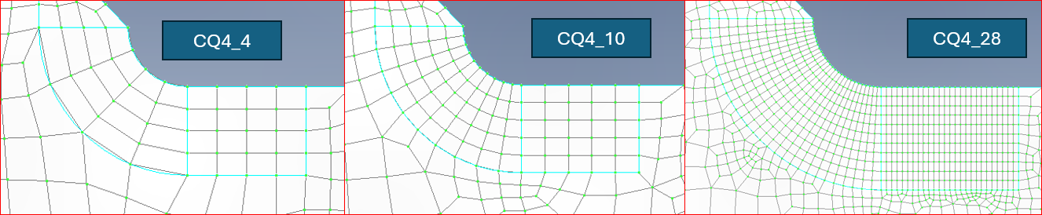
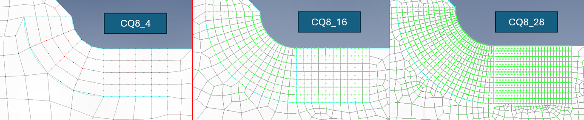
DFEM Refinement
Notes:
Exact same surrounding meshes were used
Each mesh had the same element sizes
Only difference is mid-side nodes and transition elements

Slide 22
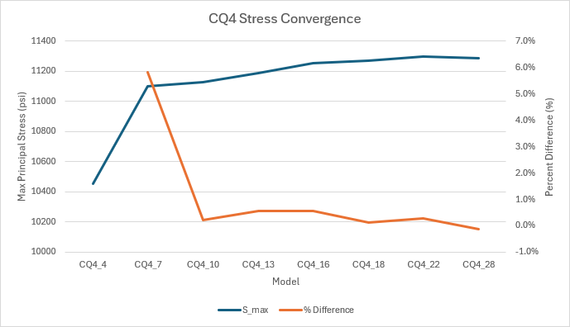
CQ4 Stress Convergence
Model | Element | NID | S_max | S_min | % Difference
CQ4_4 | 4 | 5 | 10456 | 1468
CQ4_7 | 493 | 547 | 11103 | 2361 | 5.8%
CQ4_10 | 969 | 960 | 11128 | 1966 | 0.2%
CQ4_13 | 1544 | 1468 | 11191 | 2280 | 0.6%
CQ4_16 | 2161 | 2021 | 11254 | 1835 | 0.6%
CQ4_18 | 3740 | 3429 | 11270 | 1863 | 0.1%
CQ4_22 | 11701 | 9515 | 11300 | 1533 | 0.3%
CQ4_28 | 13941 | 13338 | 11287 | 1565 | -0.1%
Notes:
Stress convergence at CQ4_16

Slide 23
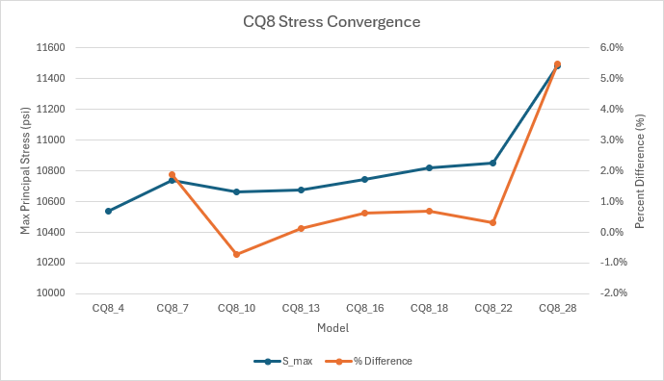
CQ8 Stress Convergence
Model | Element | NID | S_max | S_min | % Difference
CQ8_4 | 999 | 6 | 10536 | 1695
CQ8_7 | 1481 | 547 | 10738 | 1066 | 1.9%
CQ8_10 | 2146 | 961 | 10661 | 1257 | -0.7%
CQ8_13 | 2754 | 1468 | 10676 | 945 | 0.1%
CQ8_16 | 3718 | 2021 | 10744 | 626 | 0.6%
CQ8_18 | 4875 | 3429 | 10819 | 780 | 0.7%
CQ8_22 | 9851 | 9515 | 10853 | 544 | 0.3%
CQ8_28 | 11966 | 14589 | 11483 | 2381 | 5.5%
Notes:
Stresses did not converge within the same frame as CQ4 solution, stresses generally under that of CQ4

Slide 24
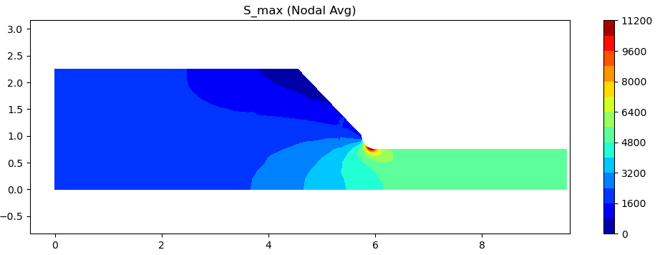
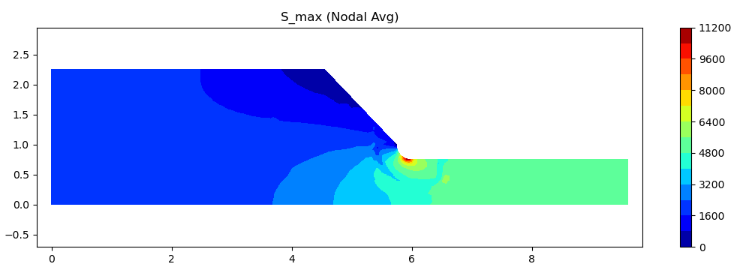
Stress Plot Comparison
CQ4
CQ8/7/6
Notes:
Note the discontinuous stress contour around the boundary of the mesh transition

Slide 25
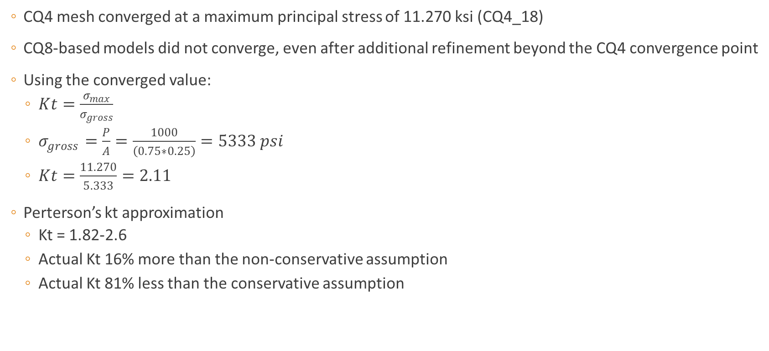
Stress Concentration Conclusions
CQ4 mesh converged at a maximum principal stress of 11.270 ksi (CQ4_18)
CQ8-based models did not converge, even after additional refinement beyond the CQ4 convergence point
Using the converged value:
$Kt=\frac{σ_{max}}{σ_{gross}}$
$σ_{gross}=\frac{P}{A}=\frac{1000}{\left(0.75∗0.25\right)}=5333 psi$
$Kt=\frac{11.270}{5.333}=2.11$
Perterson’s kt approximation
Kt = 1.82-2.6
Actual Kt 16% more than the non-conservative assumption
Actual Kt 81% less than the conservative assumption

Slide 26
Conclusions
The Python FEM solver accurately computed displacements, strains, and stresses for CTRIA3, CQUAD4, CQUAD8, and transition CQUAD6/7 elements
CQ4 meshes converged reliably, while CQ8 meshes failed to converge, likely due to transition-zone distortion and abrupt mesh-quality changes
CQ8 elements introduced extra DOFs and computational cost without improving accuracy or convergence speed
Transition regions (CQ6/CQ7) caused stress peaking and distortion, reducing CQ8 effectiveness
Recommendation: use CQ4 refinement; CQ8 with transition elements do not offer a practical advantage

